Slide 1
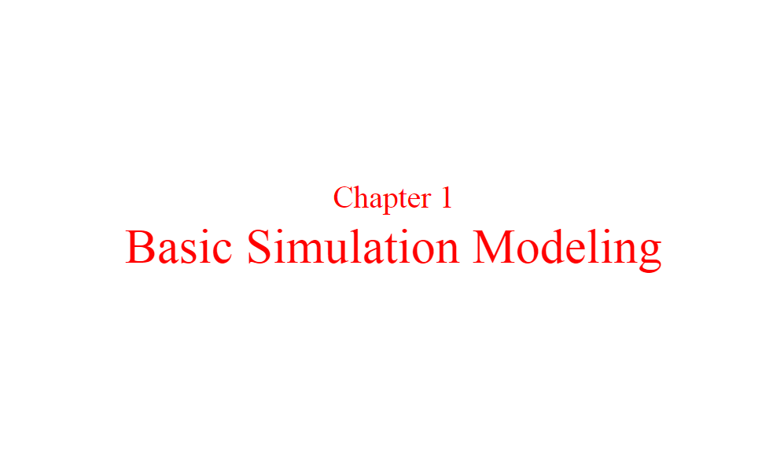
Basic Simulation Modeling
Book 01: Simulation Modeling and Analysis Averill M. Law W. David Kelton

Slide 2
The Nature of Simulation
We focus the techniques for using computers to imitate, or simulate, the operations of various kinds of real-world facilities or processes.
The facility or process of interest is usually called a system, and in order to study it scientifically we often have to make a set of assumptions about how it works.
These assumptions, which usually take the form of mathematical or logical relationships, constitute a model that is used to try to gain some understanding of how the corresponding system behaves.
Analytic solution: If the relationships that compose the model are simple enough, it may be possible to use mathematical methods (such as algebra, calculus, or probability theory) to obtain exact information on questions of interest; this is called an analytic solution.
However, most real-world systems are too complex to allow realistic models to be evaluated analytically, and these models must be studied by means of simulation.

Slide 3
The Nature of Simulation
In a simulation we use a computer to evaluate a model numerically, and data are gathered in order to estimate the desired true characteristics of the model.
……………….Example…………….
As an example of the use of simulation, consider a manufacturing company that is contemplating building a large extension on to one of its plants but is not sure if the potential gain in productivity would justify the construction cost.
It certainly would not be cost-effective to build the extension and then remove it later if it does not work out.
However, a careful simulation study could shed some light on the question by simulating the operation of the plant as it currently exists and as it would be if the plant were expanded.

Slide 4
The Nature of Simulation
Application areas for simulation are numerous and diverse. Below is a list of some particular kinds of problems for which simulation has been found to be a useful and powerful tool:
Designing and analyzing manufacturing systems
Evaluating military weapons systems or their logistics requirements
Determining hardware requirements or protocols for communications networks
Determining hardware and software requirements for a computer system
Designing and operating transportation systems such as airports, freeways, ports, and subways
Evaluating designs for service organizations such as call centers, fast-food restaurants, hospitals, and post offices
Reengineering of business processes
Analyzing supply chains
Determining ordering policies for an inventory system
Analyzing mining operations

Slide 5
The Nature of Simulation
There have been, however, several impediments, problems, to even wider acceptance and usefulness of simulation.
First, models used to study large-scale systems tend to be very complex, and writing computer programs to execute them can be an arduous, difficult, task indeed.
This task has been made much easier in recent years by the development of excellent software products that automatically provide many of the features needed to “program” a simulation model.
A second problem with simulation of complex systems is that a large amount of computer time is sometimes required.
However, this difficulty has become much less severe as computers become faster and cheaper.
Finally, there appears to be an unfortunate impression that simulation is just an exercise in computer programming, albeit a complicated one.
Consequently, many simulation “studies” have been composed of heuristic model building, programming, and a single run of the program to obtain “the answer.”
Need design and analysis of simulation models, simulation methodology, carefully.

Slide 6
Systems, Models, and Simulation
A system is defined to be a collection of entities, e.g., people or machines, that act and interact together toward the accomplishment of some logical end. [This definition was proposed by Schmidt and Taylor (1970).]
In practice, what is meant by “the system” depends on the objectives of a particular study.
The collection of entities that comprise a system for one study might be only a subset of the overall system for another.
For example, if one wants to study a bank to determine the number of tellers, cashiers, needed to provide adequate service for customers who want just to cash a check or make a savings deposit, the system can be defined to be that portion of the bank consisting of the tellers and the customers waiting in line or being served.
If, on the other hand, the loan officer and the safe-deposit boxes are to be included, the definition of the system must be expanded in an obvious way.
We define the state of a system to be that collection of variables necessary to describe a system at a particular time, relative to the objectives of a study.
In a study of a bank, examples of possible state variables are the number of busy tellers, the number of customers in the bank, and the time of arrival of each customer in the bank.

Slide 7
Systems, Models, and Simulation
We categorize systems to be of two types, discrete and continuous.
A discrete system is one for which the state variables change instantaneously at separated points in time.
A bank is an example of a discrete system, since state variables— e.g., the number of customers in the bank—change only when a customer arrives or when a customer finishes being served and departs.
A continuous system is one for which the state variables change continuously with respect to time.
An airplane moving through the air is an example of a continuous system, since state variables such as position and velocity can change continuously with respect to time.
Few systems in practice are wholly discrete or wholly continuous; but since one type of change predominates for most systems, it will usually be possible to classify a system as being either discrete or continuous.

Slide 8
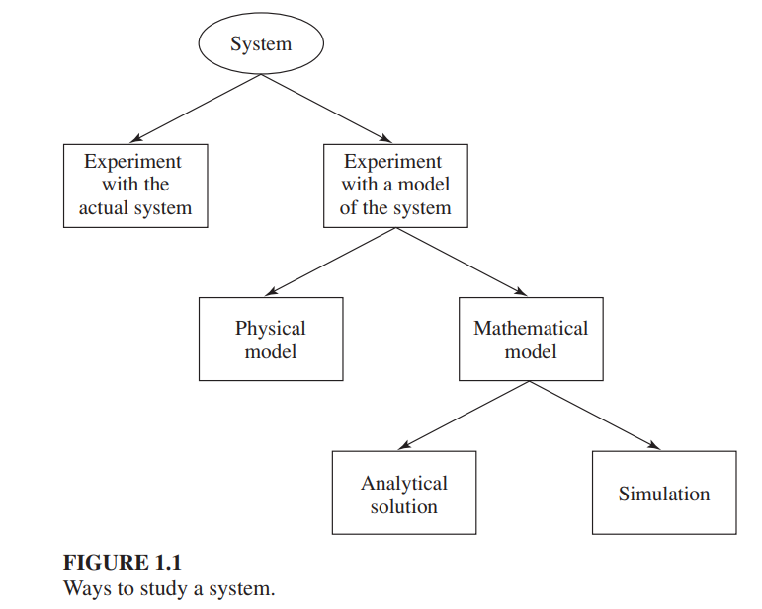

Systems, Models, and Simulation
There is a need to study them to try to gain some insight into the relationships among various components, or to predict performance under some new conditions being considered. Figure 1.1 maps out different ways in which a system might be studied.

Slide 9
Systems, Models, and Simulation
Experiment with the Actual System vs. Experiment with a Model of the System.
Experiment with the Actual System: If it is possible (and cost-effective) to alter the system physically and then let it operate under the new conditions, it is probably desirable to do so, for in this case there is no question about whether what we study is valid.
Experiment with a Model of the System: However, it is rarely feasible to do this, because such an experiment would often be too costly or too disruptive, troublesome, to the system.
For example, a bank may be contemplating reducing the number of tellers to decrease costs, but actually trying this could lead to long customer delays and alienation, unfriendliness. More graphically, the “system” might not even exist, but we nevertheless want to study it in its various proposed alternative configurations to see how it should be built in the first place.
Similar examples of this situation might be a proposed communications network, or a strategic nuclear weapons system.
For these reasons, it is usually necessary to build a model as a representation of the system and study it as a surrogate, replacement, for the actual system. When using a model, there is always the question of whether it accurately reflects the system for the purposes of the decisions to be made.

Slide 10
Systems, Models, and Simulation
Physical Model vs. Mathematical Model.
Physical Model: To most people, the word “model” evokes images of clay cars in wind tunnels, cockpits disconnected from their airplanes to be used in pilot training, or miniature supertankers scurrying about in a swimming pool. These are examples of physical models (also called iconic models).
Occasionally, however, it has been found useful to build physical models to study engineering or management systems; examples include tabletop scale models of material-handling systems, and in at least one case a full-scale physical model of a fast-food restaurant inside a warehouse, complete with full-scale, real (and presumably hungry) humans [see Swart and Donno (1981)].

Slide 11
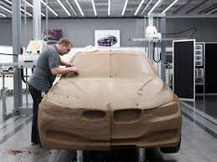
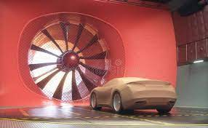
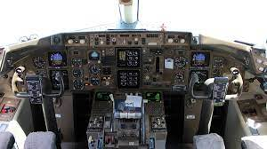
Systems, Models, and Simulation
Modelling clay or modelling compound is any of a group of malleable substances used in building and sculpting. The material compositions and production processes vary considerably.
Industrial clay: a clay model of a BMW
cockpits for airplanes

Slide 12
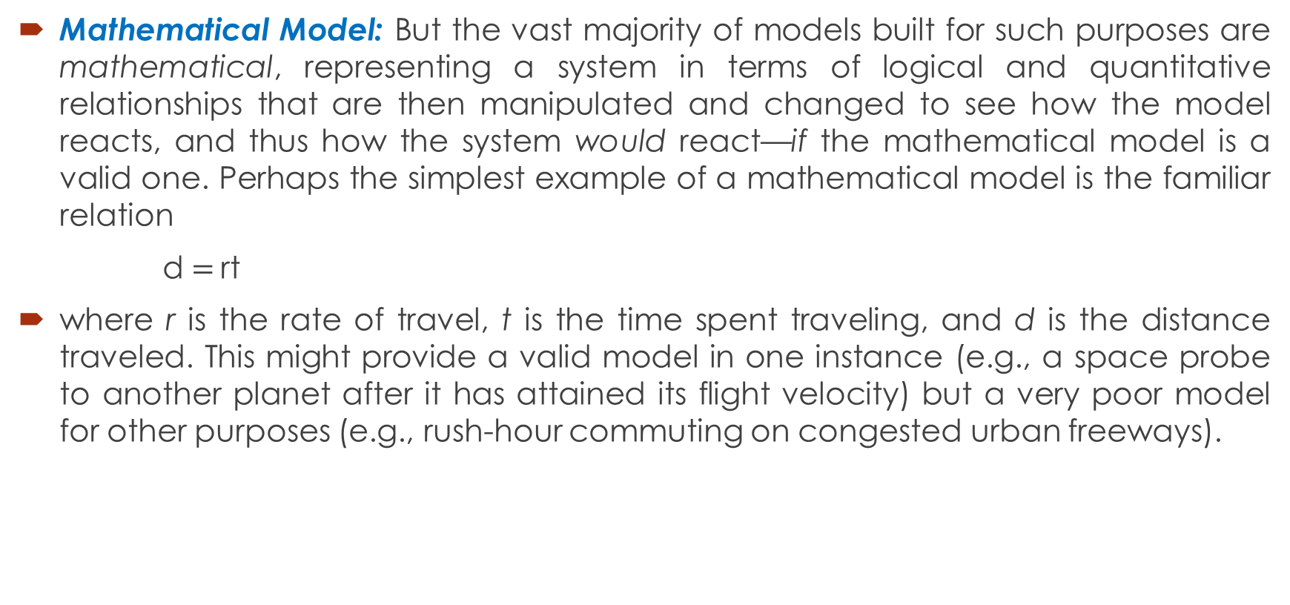
Systems, Models, and Simulation
Mathematical Model: But the vast majority of models built for such purposes are mathematical, representing a system in terms of logical and quantitative relationships that are then manipulated and changed to see how the model reacts, and thus how the system would react—if the mathematical model is a valid one. Perhaps the simplest example of a mathematical model is the familiar relation
d$=$rt
where r is the rate of travel, t is the time spent traveling, and d is the distance traveled. This might provide a valid model in one instance (e.g., a space probe to another planet after it has attained its flight velocity) but a very poor model for other purposes (e.g., rush-hour commuting on congested urban freeways).

Slide 13
Systems, Models, and Simulation
Mathematical Model: But the vast majority of models built for such purposes are mathematical, representing a system in terms of logical and quantitative relationships that are then manipulated and changed to see how the model reacts, and thus how the system would react—if the mathematical model is a valid one. Perhaps the simplest example of a mathematical model is the familiar relation
d$=$rt
where r is the rate of travel, t is the time spent traveling, and d is the distance traveled. This might provide a valid model in one instance (e.g., a space probe to another planet after it has attained its flight velocity) but a very poor model for other purposes (e.g., rush-hour commuting on congested urban freeways).

Slide 14
Systems, Models, and Simulation
Analytical Solution vs. Simulation.
Analytical Solution: Once we have built a mathematical model, it must then be examined to see how it can be used to answer the questions of interest about the system it is supposed to represent.
If the model is simple enough, it may be possible to work with its relationships and quantities to get an exact, analytical solution.
In the d = rt example, if we know the distance to be traveled and the velocity, then we can work with the model to get t = d/r as the time that will be required. This is a very simple, closed-form solution obtainable with just paper and pencil,

Slide 15
Systems, Models, and Simulation
Simulation: But some analytical solutions can become extraordinarily complex, requiring vast computing resources; inverting a large nonsparse matrix is a well-known example of a situation in which there is an analytical formula known in principle, but obtaining it numerically in a given instance is far from trivial.
If an analytical solution to a mathematical model is available and is computationally efficient, it is usually desirable to study the model in this way rather than via a simulation.
However, many systems are highly complex, so that valid mathematical models of them are themselves complex, precluding any possibility of an analytical solution.
In this case, the model must be studied by means of simulation, i.e., numerically exercising the model for the inputs in question to see how they affect the output measures of performance.

Slide 16
Systems, Models, and Simulation
Given, then, that we have a mathematical model to be studied by means of simulation (henceforth referred to as a simulation model), we must then look for particular tools to do this. It is useful for this purpose to classify simulation models along three different dimensions:
Static vs. Dynamic Simulation Models.
A static simulation model is a representation of a system at a particular time, or one that may be used to represent a system in which time simply plays no role; examples of static simulations are certain Monte Carlo models.
On the other hand, a dynamic simulation model represents a system as it evolves over time, such as a conveyor system in a factory.

Slide 17
Systems, Models, and Simulation
Deterministic vs. Stochastic Simulation Models.
If a simulation model does not contain any probabilistic (i.e., random) components, it is called deterministic; a complicated (and analytically intractable) system of differential equations describing a chemical reaction might be such a model.
Deterministic Simulation Model: In deterministic models, the output is “determined” once the set of input quantities and relationships in the model have been specified, even though it might take a lot of computer time to evaluate what it is.
Stochastic Simulation Model: Many systems, however, must be modeled as having at least some random input components, and these give rise to stochastic simulation models. (For an example of the danger of ignoring randomness in modeling a system.
Most queueing and inventory systems are modeled stochastically. Stochastic simulation models produce output that is itself random, and must therefore be treated as only an estimate of the true characteristics of the model; this is one of the main disadvantages of simulation

Slide 18
Systems, Models, and Simulation
Continuous vs. Discrete Simulation Models.
Loosely speaking, we define discrete and continuous simulation models analogously to the way discrete and continuous systems were defined above.
It should be mentioned that a discrete model is not always used to model a discrete system, and vice versa. The decision whether to use a discrete or a continuous model for a particular system depends on the specific objectives of the study.
For example, a model of traffic flow on a freeway would be discrete if the characteristics and movement of individual cars are important. Alternatively, if the cars can be treated “in the aggregate,” the flow of traffic can be described by differential equations in a continuous model.

Slide 19
Rest of the Chapter is covered from the book.
1.3 : Discrete Event Simulation
1.3.1: Time-Advance Mechanisms
Example 1.2: Next-event time-advance approach
1.3.2: Components and Organization of a discrete-event Simulation Model
1.4: Simulation of a Single-Server Queueing System
1.4.1: Problem Statement
1.4.2: Intuitive Explanation
1.4.3: Program Organization and Logic
1.4.5: C Program
1.4.6: Simulation Output and Discussion
1.4.7: Alternative Stopping Rules
1.4.8: Determining the Events and Variables

